Slide 1
CPT-S 415
Big Data
Yinghui Wu
EME B45

Slide 2
Answering queries using views

Slide 3
Data-driven Approximate Query Processing
“Big Data”
Query
Exact Answer
Long Response Times!
Compact
Data Synopses
Views
“Small Data”
Query
Approximate Answer
FAST!!
KB/MB

Slide 4
How to make big data small
Input: A class Q of queries
Question: Can we effectively find, given queries Q ∈ Q and any (possibly big) data D, a small D_{Q} such that
  Q(D) = Q(D_{Q})?
D
Q( )
Q( )
D_{Q}
Much smaller than D
  Data synopsis
  Boundedly evaluable queries
  Query answering using views
  Incremental evaluation
  Distributed query processing
Effective methods for making big data small

Slide 5
Answering queries using views
The cost of query processing: f(|D|, |Q|)
Query answering using views: given a query Q in a language L and a set V views, find another query Q’ such that
Q and Q’ are equivalent
Q’ only accesses V(D )
can we compute Q(G) without accessing G, i.e., independent of |G|?
for any G, Q(G) = Q’(G)
D
Q( )
Q’( )
V(D)
Answering pattern queries on big data:
Regardless of how big D is – the cost is “independent” of D
V(D ) is often much smaller than D (4% -- 12% on real-life data)
The complexity is no longer a function of |D|

Slide 6

Answering query using views
database
views V(D)
query A
A(V)
query result
When possible?
What to choose?
How to evaluate?
Q(D)
query result
query Q
database D
regular path queries
tree pattern query
relational algebra
XPath
XML
RDF/SPARQL
1995
1998
2000
2002
2006
2007
2011
A classical techniques
Notes:
Challenge:

Slide 7
Views revisited for Relational Data
Views are relations, except that they are not physically stored.
  a logical or virtual table based on a query.
  useful to think of a view as a stored query.
  Views are created through use of a CREATE VIEW
  command that incorporates use of the SELECT statement.
  Views are queried just like tables.
For presenting different information to different users
Employee(ssn, name, department, project, salary)
Payroll has access to Employee, others only to Developers
CREATE VIEW Developers AS
SELECT name, project
FROM Employee
WHERE department = “Development”

Slide 8
Types of Views
Virtual views:
  Used in databases
  Computed only on-demand – slower at runtime
  Always up to date
Materialized views
  A view whose tuples are stored in the database is said to be materialized
  Provides fast access, like a (very high-level) cache.
  Need to maintain the view as the underlying tables change.
  Ideally, incremental view maintenance algorithms.
  Used in data warehouses
  Precomputed offline – faster at runtime

Slide 9
A View Definition
Person(name, city)
Purchase(buyer, seller, product, store)
Product(name, maker, category)
We have a new virtual table:
Pullman-view(buyer, seller, product, store)
CREATE VIEW Pullman-view AS
SELECT buyer, seller, product, store
FROM Person, Purchase
WHERE Person.city = “Pullman” AND
Person.name = Purchase.buyer

Slide 10
Application: Querying the WWW
Assume a virtual schema, e.g.,
  Course(number, university, title, prof, quarter)
Every data source on the web contains the answer to a view over the virtual schema:
WSU database: SELECT number, title, prof
FROM Course
WHERE univ=‘WSU’ AND quarter=‘09/15’
Stanford database: SELECT number, title, prof, quarter
FROM Course
WHERE univ=‘Stanford’
User query: find all professors who teach “database systems”

Slide 11
Answering Queries Using Views
What if we want to use a set of views to answer a query?
  Given a query Q and a set of view definitions V1,…,Vn:
  Is it possible to answer Q using only the V’s?
Why?
  The obvious reason…
  Answering queries vs big variety.
  Data integration and knowledge integration
How? Query Rewriting and Query Answering
  Query rewriting based on schema information
    Query containment and minimization
  Query answering without schema information

Slide 12
Query answering using views: what can go wrong?
I still have only the result of PullmanView:
SELECT buyer, seller, product, store
FROM Person, Purchase
WHERE Person.city = ‘Pullman’ AND
Person.per-name = Purchase.buyer
but I want to answer the query
SELECT buyer, seller
FROM Person, Purchase
WHERE Person.city = ‘Pullman’ AND
Person.per-name = Purchase.buyer AND
Person.Phone LIKE ‘206 543 %’.

Slide 13
Another example
Query: q(X,Z) :- r(X,Y), s(Y,Z), t(X,Z), Y > 5.
What can go wrong?
V1(A,B) :- r(A,C), s(C1,B) (join predicate not applied)
V2(A,B) :- r(A,C), s(C,B), C > 1 (predicate too weak).
V3(A,B) :- r(A,B), r1(A,B) (irrelevant condition).
V4(A) :- r(A,B), s(B,C), t(A,C), B > 5:
needed argument is projected out. Can be recovered
if we have a functional dependency t: A --> C.

Slide 14
Dimensions of Query Rewriting Problem
View definition language
Query language
Equivalent or maximally contained rewriting (When?)
Query evaluation (How?)
Selection of views (What to select?)
Completeness/soundness of the views
Output: query execution plan or logical plan.

Slide 15
Query Containment and Equivalence: Definitions
Query Q₁ contained in query Q₂ if for every database D
Q₁(D) ⊇ Q₂(D)
Query Q₁ is equivalent to query Q₂ if Q₁(D) ⊇ Q₂(D) and Q₂(D) ⊇ Q₁(D)
Original query:
SELECT buyer, seller
FROM Person, Purchase
WHERE Person.city = ‘Pullman’
AND Person.per-name = Purchase.buyer
AND Purchase.product=‘gizmo’
Rewritten query:
SELECT buyer, seller
FROM PullmanView
WHERE product= ‘gizmo’
Note: properties of the queries, not of the database!

Slide 16
Query Rewriting: issues
Given a query Q and a set of view definitions V1,…,Vn
Q’ is a rewriting of the query using V’s if it refers only to the views or to interpreted predicates.
Q’ is an equivalent rewriting of Q using the V’s if Q’ is equivalent to Q.
Q’ is a maximally-contained rewriting of Q w.r.t. L using the V’s if there is no other Q’’ such that: Q’’ strictly contains Q’, and Q’’ is contained in Q.
The rewriting problem is NP-hard.

Slide 17
Certain Answers
Given: A query Q, View definitions V₁,…V_{n},
Extensions of the views: v₁,…v_{n} i.e. materialized views
Consider the set of databases D that are consistent with
V₁,…V_{n} and v₁,…v_{n.}
The tuple t is a certain answer to Q if it would be an answer
in every database in D.
Note: an equivalent rewriting provides all certain answers.
Schema: friends(X,Y)
T1: select X from friends (X,Y): extension: {HarryPotter}
{HarryPotter,
RonWeasley}
T2: select Y from friends (X,Y): extension: {RonWeasley}
Query: select (x,y) from friends (X,Y)

Slide 18
Finding All Answers from Views
If a rewriting is equivalent: you definitely get all answers
So what is the complexity of finding all the answers?
  [Abiteboul & Duschka, PODS-98],
  [Grahne and Mendelzon, ICDT-99]: surprisingly hard!
Certain answers:
Given specific extensions v₁,…v_{n} to the view,
is the tuple t is an answer in every database D that is
consistent with the extensions v₁,…,v_{n}?

Slide 19
Why & When is it Hard?
Sources can be:
sound (open world assumption)
complete
sound and complete (closed-world assumption)
If sources are either all sound or all complete, then
maximally-contained rewriting exists.
If sources are sound and complete, the problem is NP-complete.
Schema: friends (X,Y)
T1: select X from friends (X,Y): extension: {a}
{a, b}
?
T2: select Y from friends (X,Y): extension: {b}
Query: select (x,y) from friends (X,Y)

Slide 20
Query Rewriting Using Views
Original query:
SELECT buyer, seller
FROM Person, Purchase
WHERE Person.city = ‘Pullman’ AND
Person.per-name = Purchase.buyer AND
Purchase.product=‘gizmo’.
Rewritten query:
SELECT buyer, seller
FROM PullmanView
WHERE product= ‘gizmo’
Pullman-view(buyer, seller, product, store)

Slide 21
Graph pattern matching using views

Slide 22
Answering query using views
database
views V(D)
query A
A(V)
query result
When possible?
What to choose?
How to evaluate?
Q(D)
query result
query Q
database D
graph pattern query simulation
regular path queries
tree pattern query
relational algebra
XPath
XML
RDF/SPARQL
1995
1998
2000
2002
2006
2007
2011
A classical techniques, but still in their infancy for graphs
Notes:
Challenge:

Slide 23
Graph pattern matching by graph simulation
Input: A directed graph G, and a graph pattern Q
Output: the maximum simulation relation R
Maximum simulation relation: always exists and is unique
  If a match relation exists, then there exists a maximum one
  Otherwise, it is the empty set – still maximum
  Complexity: O((| V | + | V_{Q} |) (| E | + | E_{Q}| )
  The output is a unique relation, possibly of size |Q||V|
Using views? Incremental?

Slide 24













Querying collaborative network
customer 3
customer n
…
expensive!
project
manager
PM 1
PM 2
PM 2
PM 1
project
manager
tester
developer 2
customer 2
developer 3
customer
developer
developer 1
query 1
customer 2
developer 3
customer
developer
customer 2
customer 1
A collaborative pattern
…
developer 3
Customer
developer
customer 3
views
developer k
query 2
developer 2
customer 3
developer 2
A collaborative (chat) network
Amrit Chintan et al, Information System management, 2010
Detecting Coordination Problems in Collaborative Software Development Environments,

Slide 25


patterns and views
view 1
customer 2
(view definition)
edges | matches
(project manager, developer) | {(PM 1, developer 2), (PM 2, developer 3)}
(project manager, customer) | {(PM 1, customer 2), (PM 2, customer 2),
customer
developer
developer 3
customer
developer
pattern query
customer 3
developer 2
view definition 1
view extension 1
view 2
query result
project
manager
edges | matches
(customer, developer) | {(customer 2, developer 2), (customer 3, developer 3)}
(developer, customer) | {(developer 2, customer 2), (developer 2, customer 3), (developer 3, customer 2)}
binary relation
node match: satisfies predicates
edge match: connects two node matches
edges | matches
(customer, developer) | {(customer 2, developer 2), (customer 3, developer 3)}
(developer, customer) | {(developer 2, customer 2), (developer 2, customer 3), (developer 3, customer 2)}
customer
developer
view definition 2
(view extension)
view extension 2
Notes:
Theories of answering queries using views, A.Y.Halevy, SIGMOD record.
We are not addressing rich semantics of node label; also we are not addressing integration.

Slide 26
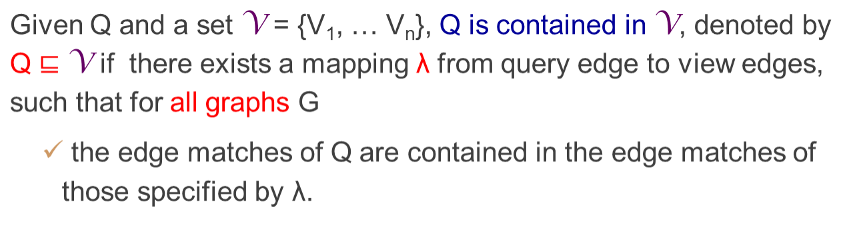
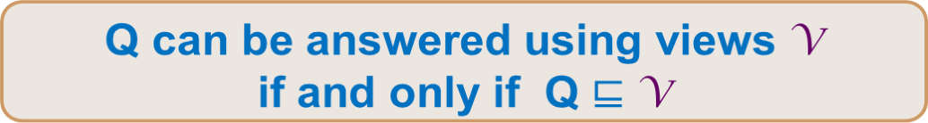
When a pattern can be matched using views
A necessary and sufficient condition
Pattern containment: a characterization
Notes:
Give a picture here.

Slide 27






Pattern containment
(project manager, developer) | (PM 1, developer 2)
(project manager, customer) | (PM 1, customer 2)
(developer, customer) | (developer 2, customer 2)
(customer, developer) | (customer 2, developer 2)
project
manager
Query result
project
manager
customer
developer
View 1
View 2
customer
developer
customer
developer
(project manager, developer) | {(PM 1, developer 2), (PM 2, developer 3)}
(project manager, customer) | {(PM 1, customer 2), (PM 2, customer 2)}
(customer, developer) | {(customer 2, developer 2), (customer 3, developer 3)}
(developer, customer) | {(developer 2, customer 2), (developer 2, customer 3), (developer 3, customer 2)}
How to determine the existence of λ?
Notes:
Give a picture here.

Slide 28
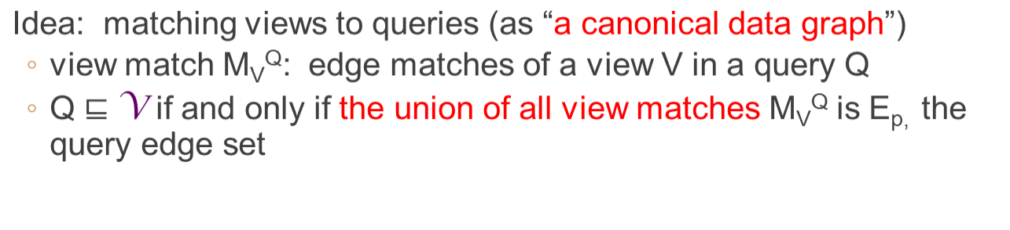
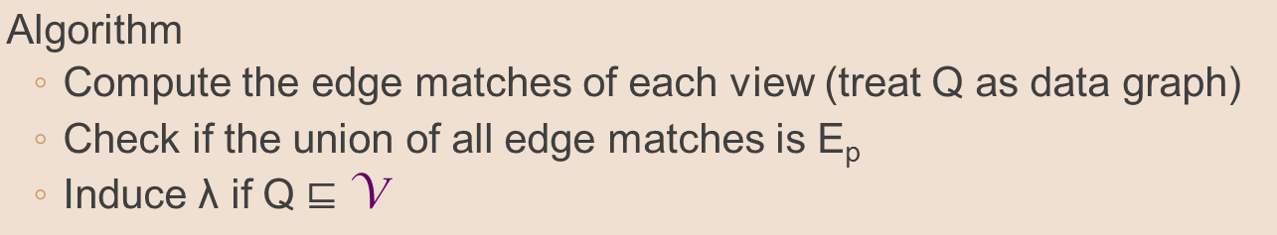
Determining Pattern containment
NP-complete for relational conjunctive queries, undecidable for relational algebra
A practical characterization: patterns are small in practice

Slide 29
Pattern containment: example
project
manager
λ
customer
developer
project
manager
project
manager
View 1
customer
developer
customer
developer
Query containment: given Q and Q’, it is to determine whether for any graph G, Q(G) is contained in Q’(G)?
A classical problem.
What is its complexity for pattern queries?
query
as “data graph”
view matches
efficient
customer
developer
View 2
V: the set of views; Q: query

Slide 30



Test: Pattern query containment
PM
PM
e₁
e₂
View 1
PRG
DBA
PRG
DBA
e₃
View 2
PRG
e₄
DBA
DBA
PRG
Pattern query
It takes 0.5 second to check containment of large cyclic patterns
Notes:
Computing graph matches in batch style is expensive.
We find new matches by making maximal use of previous computation, without paying the price of the high complexity of graph pattern matching.

Slide 31

Query evaluation using views
Input: pattern query Q, graph G, a set of views V and extensions in G, and a mapping λ
Output: Find the query result Q(G)
Algorithm
  Collect edge matches for each query edge e and λ(e)
  Iteratively remove non-matches until no change happens
  Return Q(G)
Recall simulation algorithm
More efficient.
  Q(G) can be evaluated in O(|Q||V(G)| + |V(G)|²) time

Slide 32
Query evaluation using views
query
project
manager
“bottom-up” strategy
(project manager, developer) | {(PM 1, developer 2), (PM 2, developer 3)}
(project manager, customer) | {(PM 1, customer 2), (PM 2, customer 2)}
(developer, customer) | {(developer 2, customer 2), (developer 2, customer 3), (developer 3, customer 2)}
(customer, developer) | {(customer 2, developer 2), (customer 3, developer 3)}
customer
developer
project
manager
Query result
View 1
View 2
customer
developer
customer
developer
(project manager, developer) | {(PM 1, developer 2), (PM 2, developer 3)}
(project manager, customer) | {(PM 1, customer 2), (PM 2, customer 2)}
(customer, developer) | {(customer 2, developer 2), (customer 3, developer 3)}
(developer, customer) | {(developer 2, customer 2), (developer 2, customer 3), (developer 3, customer 2)}
4% -- 12% of G
Are we done yet?
Without accessing the underlying big graph G

Slide 33

What views to choose?
choose all?
project
manager
customer
project
manager
customer
developer
customer
developer
software
software
tester
view 1
view 2
query
project
manager
project
manager
developer
customer
developer
tester
customer
developer
customer
developer
software
software
view 3
view 4
efficiency
software
software
view 5
view 6
Why do we care?

Slide 34
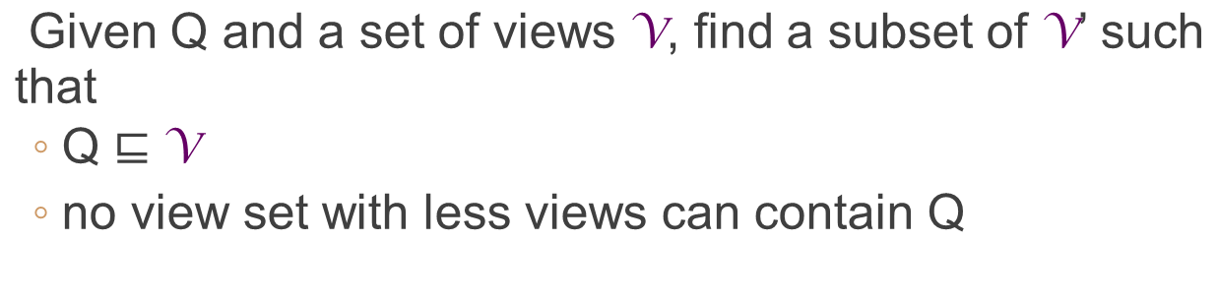
Minimum containment
Minimum containment is NP-complete
  APX-hard as optimization
  - no PTIME algorithm that gives approx. ratio within arbitrarily given constant factor
two options
What can we do?

Slide 35
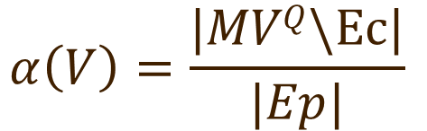

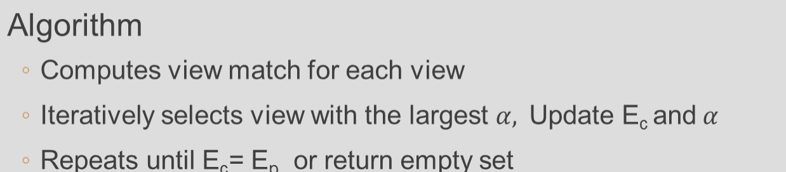
An log|Ep|-approximation
Idea: greedily select views V that “cover” more query edges
E_{c}: already covered
To decide whether to include a particular view V
Approximation: performance guarantees

Slide 36





Minimum containment: example
project
manager
Ec
customer
customer
project
manager
developer
customer
developer
software
software
tester
view 1
view 2
query
project manager
project manager
developer
customer
developer
tester
customer
developer
customer
developer
software
software
view 3
view 4
software
software
view 5
view 6
Greedy: based on the metric

Slide 37
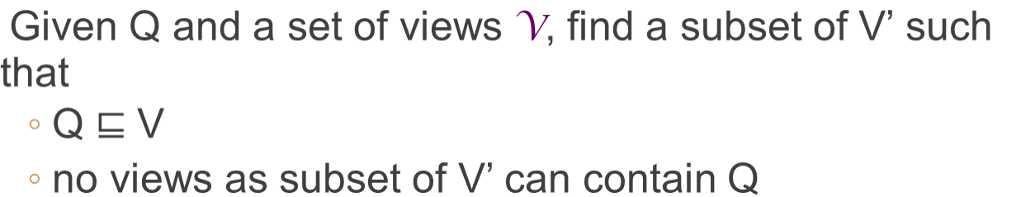
Minimal containment
  O(|Q|² card(V) + |V|² + |Q| |V|) time
Algorithm
  Computes view match for each view
  Iteratively selects a view that extends E_{c}
  Repeats until Ec= Ep or return empty set
new addition
Minimal containment is in PTIME

Slide 38

Minimal containment: example
project
manager
project
manager
customer
customer
developer
customer
developer
software
view 1
software
tester
view 2
query
project manager
project manager
developer
customer
developer
tester
customer
developer
customer
developer
software
software
view 3
view 4
software
software
view 5
view 6
Eliminate redundant views

Slide 39
Putting together
Problem | Complexity | Algorithm
containment | PTIME | O(card(V)|Q|²+|V|²+|Q||V|)
minimum containment | NP-c/APX-hard | log|E_{p}|-approximable O(card(V)|Q|²+|V|²+|Q||V|+|Q|card(V)^{3/2})
minimal containment | PTIME | O(card(V)|Q|²+|V|²+|Q||V|)
evaluation | PTIME | O(|Q||V(G)| + |V(G)|²)
characterization: sufficient and necessary condition for deciding whether a query can be answered using a set of views
evaluation: how to evaluate queries using views
view section: what views to choose for answering queries
Subgraph isomorphism?
View maintenance?
The study is still in its infancy for graph queries

Slide 40
Summing up

Slide 41
Making big data small
Yes, it is doable!
Approximate query models (query-driven approximation)
Data synopsis: property preserving (data-driven approximation)
Bounded evaluable queries: dynamic reduction (principled search scheme)
Query answering using views: (make big data small)
  query evaluation by only accessing views
Incremental query answering: (coping with dynamic data; next lecture)
  depending on the size of the changes rather than the size of the original big data
. . .
Combinations of these are more effective

Slide 42
Summary and review
What is query answering using views?
What is query containment? What is the complexity of deciding query containment for relations? For XML? Graph pattern queries via graph simulation?
What questions do we have to answer for answering graph queries using views?
What is incremental query evaluation? What are the benefits?
What is a unit update? Batch updates?
When can we say that an incremental problem is bounded? Semi-bounded?
How to show that an incremental problem is bounded? How to disprove it?

Slide 43
Papers for you to review
W. Le, S. Duan, A. Kementsietsidis, F. Li, and M. Wang. Rewriting queries on SPARQL views. In WWW, 2011.
http://www.cs.fsu.edu/~lifeifei/papers/rdfview.pdf
D. Saha. An incremental bisimulation algorithm. In FSTTCS, 2007. http://cs.famaf.unc.edu.ar/~rfervari/sites/all/files/readings/incremental-bis-07.pdf
S. K. Shukla, E. K. Shukla, D. J. Rosenkrantz, H. B. H. Iii, and R. E. Stearns. The polynomial time decidability of simulation relations for finite state processes: A HORNSAT based approach. In DIMACS Ser. Discrete, 1997. (search Google Scholar)
W. Fan, X. Wang, and Y. Wu. Answering Graph Pattern Queries using Views, ICDE 2014. (query answering using views)
W. Fan, X. Wang, and Y. Wu. Incremental Graph Pattern Matching, TODS 38(3), 2013. (bounded incremental query answering)

Slide 44
Papers to read
Shoubridge P., Kraetzl M., Wallis W. D., Bunke H. Detection of Abnormal Change in a Time Series of Graphs. Journal of Interconnection Networks (JOIN) 3(1-2):85-101, 2002.
Shoubridge, P. Kraetzl, M. Ray, D. Detection of abnormal change in dynamic networks. Information, Decision and Control, 1999.
Kelly Marie Kapsabelis, Peter John Dickinson, Kutluyil Dogancay.
Investigation of graph edit distance cost functions for detection of network
anomalies. ANZIAM J. 48 (CTAC2006) pp.436–449, 2007.
Panagiotis Papadimitriou, Ali Dasdan, Hector Garcia-Molina. Web graph similarity for anomaly detection. J. Internet Services and Applications (JISA) 1(1):19-30 (2010)
B. Pincombe. Anomaly Detection in Time Series of Graphs using ARMA Processes. ASOR BULLETIN, 24(4):2, 2005.
Gao, Xinbo and Xiao, Bing and Tao, Dacheng and Li, Xuelong. A survey of graph edit distance. Pattern Anal. and App.s 13 (1), pp. 113-129. 2010.
Horst Bunke, Peter J. Dickinson, Andreas Humm, Christophe Irniger, Miro Kraetzl: Computer Network Monitoring and Abnormal Event Detection Using Graph Matching and Multidimensional Scaling. Industrial Conference on
Data Mining 2006:576-590

Slide 45
Papers to read
C.E. Priebe, J.M. Conroy, D.J. Marchette, and Y. Park. Scan Statistics on Enron Graphs. Computational & Mathematical Organization Theory, 11(3):229–247, 2005.
Ide, T. and Kashima, H., Eigenspace-Based Anomaly Detection in Computer Systems. KDD, 2004.
L. Akoglu, M. McGlohon, C. Faloutsos. Event Detection in Time Series of
Mobile Communication Graphs. Army Science Conference, 2010.
Sun, Jimeng and Xie, Yinglian and Zhang, Hui and Faloutsos, Christos. Less is more: Compact matrix representation of large sparse graphs. ICDM 2007.
Sun, Jimeng and Tao, Dacheng and Faloutsos, Christos. Beyond streams
and graphs: dynamic tensor analysis. KDD 2006: 374-383
Sun J., Faloutsos C., Papadimitriou S., Yu P. S. GraphScope: parameter-free mining of large time-evolving graphs. KDD, 2007.
R. Rossi, B. Gallagher, J. Neville, and K. Henderson. Role-Dynamics: Fast Mining of Large Dynamic Networks. 1st Workshop on Large Scale Network Analysis, WWW, 2012.
Cemal Cagatay Bilgin , Bülent Yener . Dynamic Network Evolution: Models, Clustering, Anomaly Detection. Survey, 2008.

